Slide 1
Realty Price Prediction
Group members
Ali fawad hassan (02-134191-094)
Shahzain shafique (02-134191-051)
Basil aslam 02-134191-002)

Slide 2
Abstract
House price forecasting is an important topic of real estate.
The literature attempts to derive useful knowledge from historical data of property markets.
Machine learning techniques are applied to analyze historical property transactions in Pakistan to discover useful models for house buyers and sellers.
Revealed is the high discrepancy between house prices in the most expensive and most affordable suburbs in the city of Karachi.

Slide 3
Introduction
The real estate industry is a big one, with a lot of people involved, from regulators to private companies and investors.
There is a considerable need among these stakeholders for a better grasp of the industry's operational mechanisms and driving causes.
Today, there is a wealth of data on pertinent statistics as well as other contextual elements, and it is natural to want to make sense of it all in order to better understand the sector.

Slide 4
Aim and Importance
The goal is to forecast the most cost-effective property pricing for real estate buyers based on their budgets and goals.
Future prices will be projected by examining recent market trends and price ranges, as well as forthcoming changes.
The system works by combining the application with a website that accepts customer specifications.

Slide 5
Need and Motivation
The general and standardized real estate characteristics are often listed separately from the asking price and general description.
Because these characteristics are separately listed in a structured way, they can be easily compared across the whole range of potential houses.
Because every house also has its own unique characteristics, such as a particular view or type of sink, house sellers can provide a summary of all the important features of the house in the description.

Slide 6
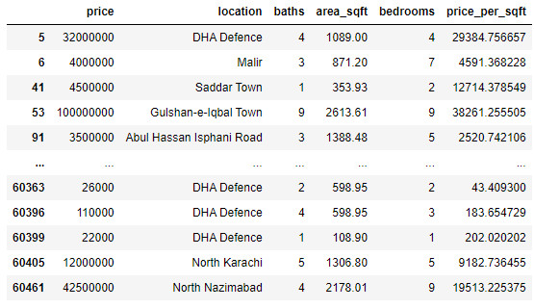
Dataset
Here we have web scrapped the Data from zameen.com.pk website which is one of the leading real estate websites operating in PAKISTAN. Our Data contains Karachi Houses only. Dataset looks as follows-

Slide 7
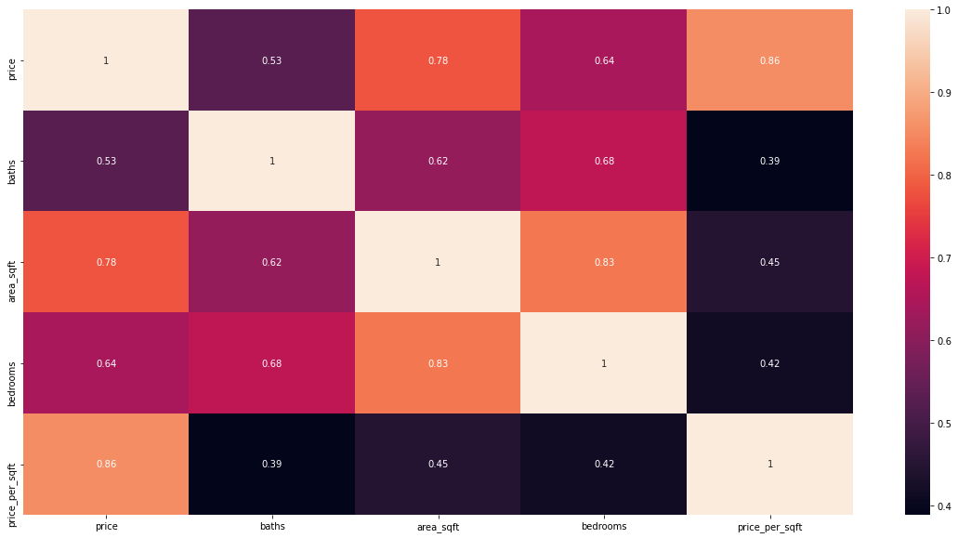
Correlation Heatmap
A correlation heatmap is a heatmap that shows a 2D correlation matrix between two discrete dimensions, using colored cells to represent data from usually a monochromatic scale.

Slide 8
Model Used
So, our study showed that Decision Tree Model displayed the best performance for this Dataset and can be used for deploying purposes.
Linear regression model and lasso model are far behind, so can’t be recommended for further deployment purposes.

Slide 9
Language Used
Python is widely used in scientific and numeric computing:
SciPy is a collection of packages for mathematics, science, and engineering.
Pandas is a data analysis and modelling library.
NumPy, which stands for Numerical Python, is a library consisting of multidimensional array objects and a collection of routines for processing those arrays. Using NumPy, mathematical and logical operations on arrays can be performed.
The Software Carpentry Course teaches basic skills for scientific computing, running boot camps and providing open-access teaching materials.

Slide 10
Libraries Used
Pandas
NumPy
Matplotlib
Seaborn
sklearn

Slide 11
Deployment
The Model is deployed through Python, Flask as backend and HTML CSS and JAVASCRIPT as front end.
The Front End designed for the price prediction of houses in Karachi is shown below with some examples:

Slide 12
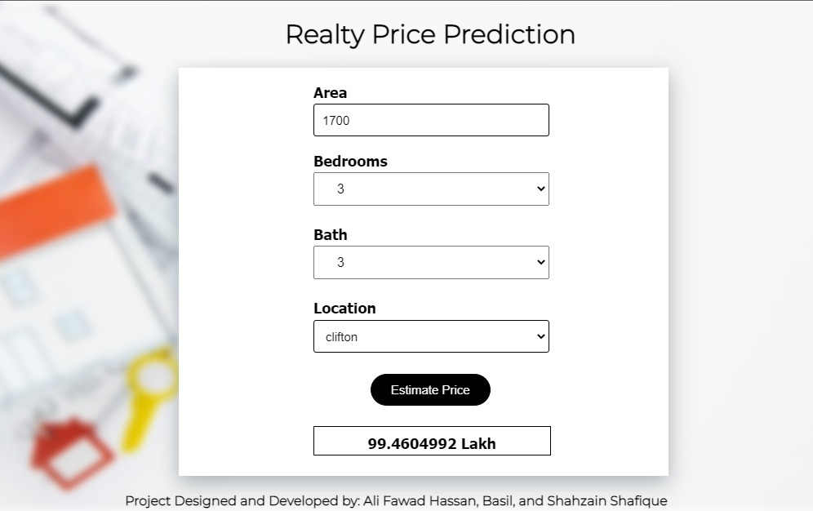
Front End

Slide 13
Conclusion
In today's real estate environment, storing and extracting such large amounts of data for one's personal needs has become difficult.
Furthermore, the information gathered should be useful.
The Data Mining Algorithm is used to its full potential by the system.
The system makes the most efficient use of such information.
By raising the accuracy of estate selection and lowering the risk of investing in an estate, the Data mining algorithm helps to satisfy clients.

